Slide 1
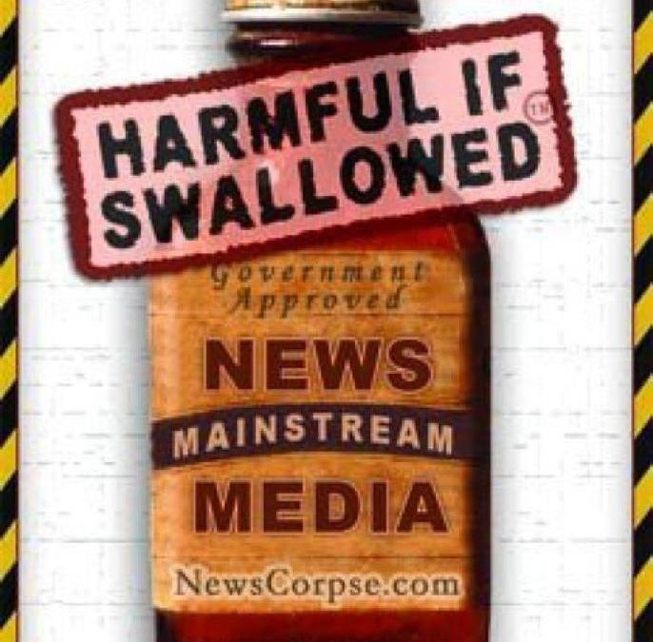
Healthcare in the U.S. vs the U.K. or Just About Anywhere: Don’t let the Fourth Estate Steer You Wrong
Mark O. Dietrich, CPA/ABV
Integra International
Philadelphia May 20, 2017

Slide 2
Programme
How Health Insurance “works” in the U.S.
Contrasts and similarities among major healthcare systems
Globalisation of regulatory schemes
How the U.S. Exports Wealth to the G-7 and others via Rx Drug Subsidies
Private/Public Equity versus the (so-called) Not for Profit Players
With thanks to Ray Stanbridge, Stanbridge Accountants, Lincoln, UK for his insights on Australia, New Zealand and UK

Slide 3
Prologue
“It’s about 650 miles from Paris, France to Berlin, Germany. It’s about that far from Boston to Charlottesville, Virginia and from San Francisco to Portland, Oregon. And, its about 3,000 miles from Portland to The Big Apple. Along the way from West to East, you pass over mountains, through deserts and vast hectares of farmland where very few people live. Point is, a lot of things change when you move far away from a given location. Lifestyle, food, environment, health and – guess what – healthcare. There are a lot of rather silly comparisons between European-style healthcare systems for small countries you can easily cross in half a day and the United States, one of the largest countries by square miles in the world and with an ethnically diverse population. These comparisons are similar in foolishness to the comparisons of public transit systems in countries the size of American states. The population of England is about 51 million in an area less than the state of Oregon, whose population is less than 4 million. England is 9 times more densely populated than the US: I’ll betcha that makes public transit work better – if you can find a seat.” (Dietrich, Financial Professional’s Guide to Healthcare Reform, 2012)

Slide 4
Healthcare in the United States
Highest per capita spending in the world
Vast regional differences in spending, access, quality, practice patterns, etc. – it’s a big place
Compare Massachusetts and Mississippi, for example
In 2014, there were 265.5 active physicians per 100,000 population in the United States, ranging from a high of 432.4 in Massachusetts to a low of 184.7 in Mississippi. The states with the highest number of physicians per 100,000 population are concentrated in the Northeast.
This simple example illustrates how meaningless national comparisons can be
Note: I have done healthcare valuation and consulting work in 40 states, and lectured in most of them
Heavily influenced by institutional lobbyists – American Hospital Association (AHA), American Medical Association (AMA), America’s Health Insurance Plans (AHIP), Pharmaceutical Research and Manufacturers of America (Big Pharma), and, yes, AARP

Slide 5
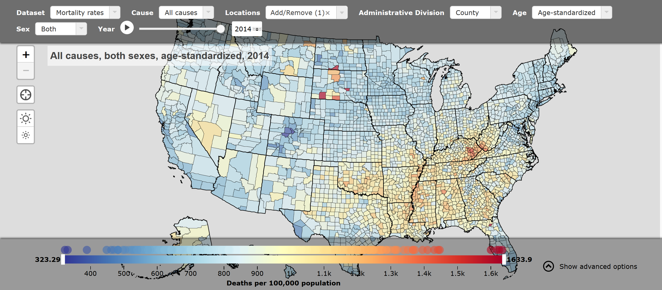
http://www.healthdata.org/news-release/growing-gap-between-longest-and-shortest-lifespans-us-emphasizes-need-policy-action

Slide 6
Winston Churchill
"A politician needs the ability to foretell what is going to happen tomorrow, next week, next month, and next year. And to have the ability afterwards to explain why it didn't happen.”

Slide 7
Obamacare: An easily foreseen Disaster (I wrote a book about it In 2012!)
Americans were sold a “pig in a poke” by politicians and consultants who either had no idea what they were doing, or more likely, deliberately misled them – or both
Heinlein's Razor: "Never attribute to malice that which is adequately explained by stupidity - but don't rule out malice."
Obamacare, and the ‘new’ American Health Care Act as well, can never succeed because they fail to address the two core failings of the American System
The 4 prong structure of the health insurance markets
The excessive market leverage and costs of large hospital systems

Slide 8
Jonathan Gruber, MIT Professor, Obamacare Architect, and Ivory Tower Resident
The ACA was designed “ … to leave vast majority of Americans alone. People who had health insurance that worked for them through their employers or government were not designed to be affected by the law.”
Like MIT Professors, for example
“… Second is very healthy individuals, who benefited from a previously discriminatory insurance market. Before, insurers could kick sick people out. Well that’s bad for sick people and good for healthy people."
Not like MIT Professors, who are in the self-insured market - next

Slide 9
Gruber’s Obamacare Strategy Summed
Alleged Fact 1-Healthy people unfairly benefited from the old insurance rules in the individual market
Alleged Fact 2 - People who had health insurance through their employers or government shouldn't be bothered
Therefore, it is good policy to charge healthy people exorbitant premiums in the individual market
Healthy individuals in the individual market became the Straw Man for Obamacare proponents

Slide 10
Insurance
Actuarial risk (the driver of premiums) is to a great degree a function of the size of the risk pool and the relative health of those in that pool, and the individual market is the riskiest (sickest people, smallest number of people in risk pool), followed by the small group market. Obamacare was to a large extent focused on reforming and expanding the individual market, as well as dictating benefit structure there and in the small group market.

Slide 11
Insurance
“When the insurer establishes a premium for health insurance, it not only projects its expected cost outlays for subscriber medical care and administrative expenses, but also projects how much of that cost will be born directly by the subscriber through deductibles, co-pays and out of pocket payments. For example, the 2016 Milliman Medical Index* found that the typical family of four had $25,800 of total medical spending, of which ~16.67% was borne by the consumer through out of pocket expenses and the balance paid through health insurance premiums. Thus, an insurer in this scenario would see expenses (here including administration costs) of $2,150 per member per month, of which $360 would be paid by the insured, leaving $1,790 for the premium.” (Forthcoming chapter by Dietrich on capitation)
* http://www.milliman.com/uploadedFiles/insight/Periodicals/mmi/2016-milliman-medical-index.pdf

Slide 12
Insurance Markets in the U.S.
Self-insured market
Large group market
Small group market
Individual market
Ranked in order of where one would be better off …

Slide 13
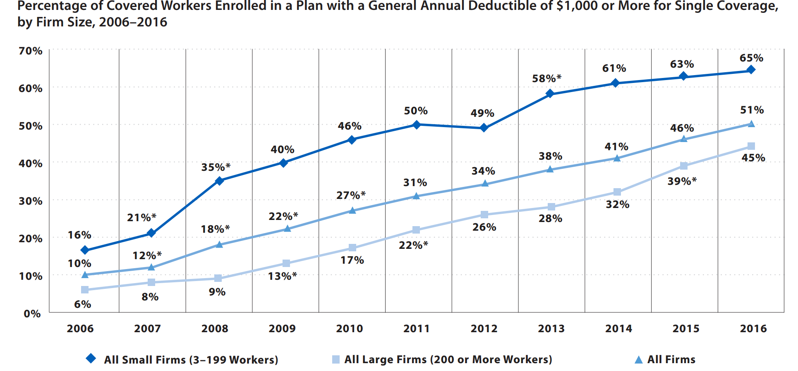
Small Firms have lower benefits and higher costs: Kaiser/hret employer health benefits survey 2016

Slide 14
Insurance Markets in the U.S.
Self-Insured
82% of all firms in excess of 200 workers self-insure in whole or in part
94% of firms with 5,000 or more workers self-insure
More than half of all workers are employed in firms with 500 or more employees and another 14% are employed in firms with more than 100 and less than 500 workers
Nearly two-thirds of all workers are out of the risk pool for the small group and individual market!
See, e.g., http://kff.org/health-costs/report/2016-employer-health-benefits-survey/

Slide 15
Insurance Markets in the U.S.
Large Group
Historically, more than 50 insured employees, now more than 100
See below
Small Group
Historically, less than 50 but now less than 100.
Why the change? To FORCE more insureds into the small group market to subsidize the higher costs in the small group market.
No such burden on the re-defined Large Group and Self-Insured markets.
Obamacare permits states to merge the small group market with the individual market, which is what Romney did in Massachusetts with catastrophic results that remain unfixed

Slide 16
Insurance Markets in the U.S.
Individual Market
Targeted by Obamacare and the AHCA
Home to those with preexisting conditions, many who cannot work, self-employed individuals and those otherwise ineligible for public programmes such as Medicaid
An actuarial nightmare that cannot be fixed
Actuarial Nightmare
~6% of insured in this pool, BUT, each state has its own pool and the number of insureds varies radically
The small number of healthy individuals are stuck with the cost of covering those with preexisting conditions, while 94% of the insured avoid the cost …

Slide 17
Across a pond or two
Australia and the UK

Slide 18
Australia vs U.S.
Remember what I said in the Prologue about population density
Spends around 9.4% of GDP on Healthcare vs 17.1% in U.S. in 2014
Per capita spending in US dollars of $6,031 in Aus. vs $9,403 in U.S.
Physicians per 1,000 population of 3.3 in Aus. vs 2.5 in U.S.
Hospital beds per 1,000 population of 3.9 in Aus. vs 2.9 in U.S.
Percent of healthcare spending by government 67% in Aus. vs 48% in U.S. (Depending on what source you use)
89% of population in Australia is urban vs 82% in U.S.!
http://data.worldbank.org/indicator/SH.XPD.TOTL.ZS

Slide 19
Australia
Government collects a 2% Medicare tax on taxable incomes
Government pays significant portion of expenses, e.g., 75% general practitioner; 85% specialist services and 100% in-hospital care costs
Patient pays fixed cost per Rx, with government picking up balance
Certain services are not covered, e.g., dentistry, optometry and ambulance

Slide 20
Australia
Australians are required to have private medical insurance to cover the out of pocket expense, or higher income earners pay an additional 1-1 ½% tax.
Some of this cost is rebated/subsidised depending on income level
I did not hear any reporting by the 4th estate about this requirement when the Aussie PM was here
Insurance is “community rated” with no discrimination for medical history, age and health status BUT (and a BIG but) pre-existing conditions may have a waiting period of up to 12 months

Slide 21
New Zealand quick hit
Approximately 25% of New Zealanders have private health insurance due to long waits in the government hospitals
Charges are made for primary care visits
THERE ARE NO LAWSUITS PERMITTED AGAINST DOCTORS, HOSPITALS, ETC. FOR MEDICAL ACCIDENTS
There is a tight immigration policy to preclude unhealthy individuals from immigrating!

Slide 22
U.K. vs U.S.
Remember what I said in the Prologue about population density - and about state to state differences in US
Spends around 9.1% of GDP on Healthcare vs 17.1% in U.S. in 2014
Per capita spending in dollars of $3,935 in UK vs $9,403 in U.S.
Physicians per 1,000 population of 2.8 in UK vs 2.5 in U.S.
Hospital beds per 1,000 population of 2.9 in UK vs 2.9 in U.S.
Percent of healthcare spending by government 83% in UK vs 48% (Depending on what source you use)
83% of population (65 mill) is urban (8.7 mill in London) vs 82% in U.S.!
http://data.worldbank.org/indicator/SH.XPD.TOTL.ZS
http://data.worldbank.org/indicator/SP.URB.TOTL.IN.ZS

Slide 23
National Health Service (NHS)
Founded in 1948
Byzantine structure, heavily populated with political appointees and high management costs
Clinical Commissioning Groups (CCGs) commission most of the hospital and community NHS services in their local area
NHS Trusts get money from CCGs and own hospitals and equipment, etc.
GPs (general practitioners) control vast sums of spending in the UK through a system similar to capitation; many of these practices are privately owned and the doctors make substantial incomes.

Slide 24
Private medical insurance (PMI)
My visit to the Lincoln Cathedral (ca 1088), time permitting
Why PMI?
Longggg waits for services in many, but not all, CCG districts
Quality concerns
Certain drugs and treatments not available through NHS
Represents as much as 20% of overall spending in UK
Much of this is concentrated in London, with more than 15% having PMI
There is no tax deduction for health insurance, there is actually a tax on premiums of 12%
NHS contracts with private medical providers through the CCGs; now represents around 30% of all NHS spending

Slide 26
A Look Back in Time
When I first spoke in London to FIPO and LCA* in 2009, I observed that “The types of incentive payments to physicians by hospitals in the UK for bringing patients in would likely be illegal in the US – something to think about…”
*Federation of Independent Practitioners and London Consultants Association

Slide 27
Winston Churchill
"We can always count on the Americans to do the right thing, after they have exhausted all the other possibilities."

Slide 28
Exporting REGULATORY SCHEMES
The U.K. Competition Commission referred to financial practices between hospitals and physicians as AECs or Adverse Effect(s) on Competition
In U.S., these AECs are regulated in three principal manners
Anti-Trust law – separate regulation of competition*
Anti-Kickback Statute – prohibition of payment for referrals of healthcare services (criminal)
Stark Anti-Referral Law – statute regulating relationship between physicians, hospitals and ancillary service providers (civil)
*Abysmal failure in the U.S. to a large extent where the healthcare industry is concerned

Slide 29
Exporting REGULATORY SCHEMES
Competition Commission
Ruled in 2014 that consumers were being overcharged and ordered U.S.-based HCA to sell two of its London hospitals
HCA ultimately prevailed and is now actively engaged in buying up both primary care and specialist practices
Doctors were not so lucky, and found most of the incentive payments – as predicted by one Mark O. Dietrich in 2009 – banned
The U.S. Corrupt Foreign Practices Act, although only applicable to government officials, has a significant influence on how U.S. companies conduct private business

Slide 30
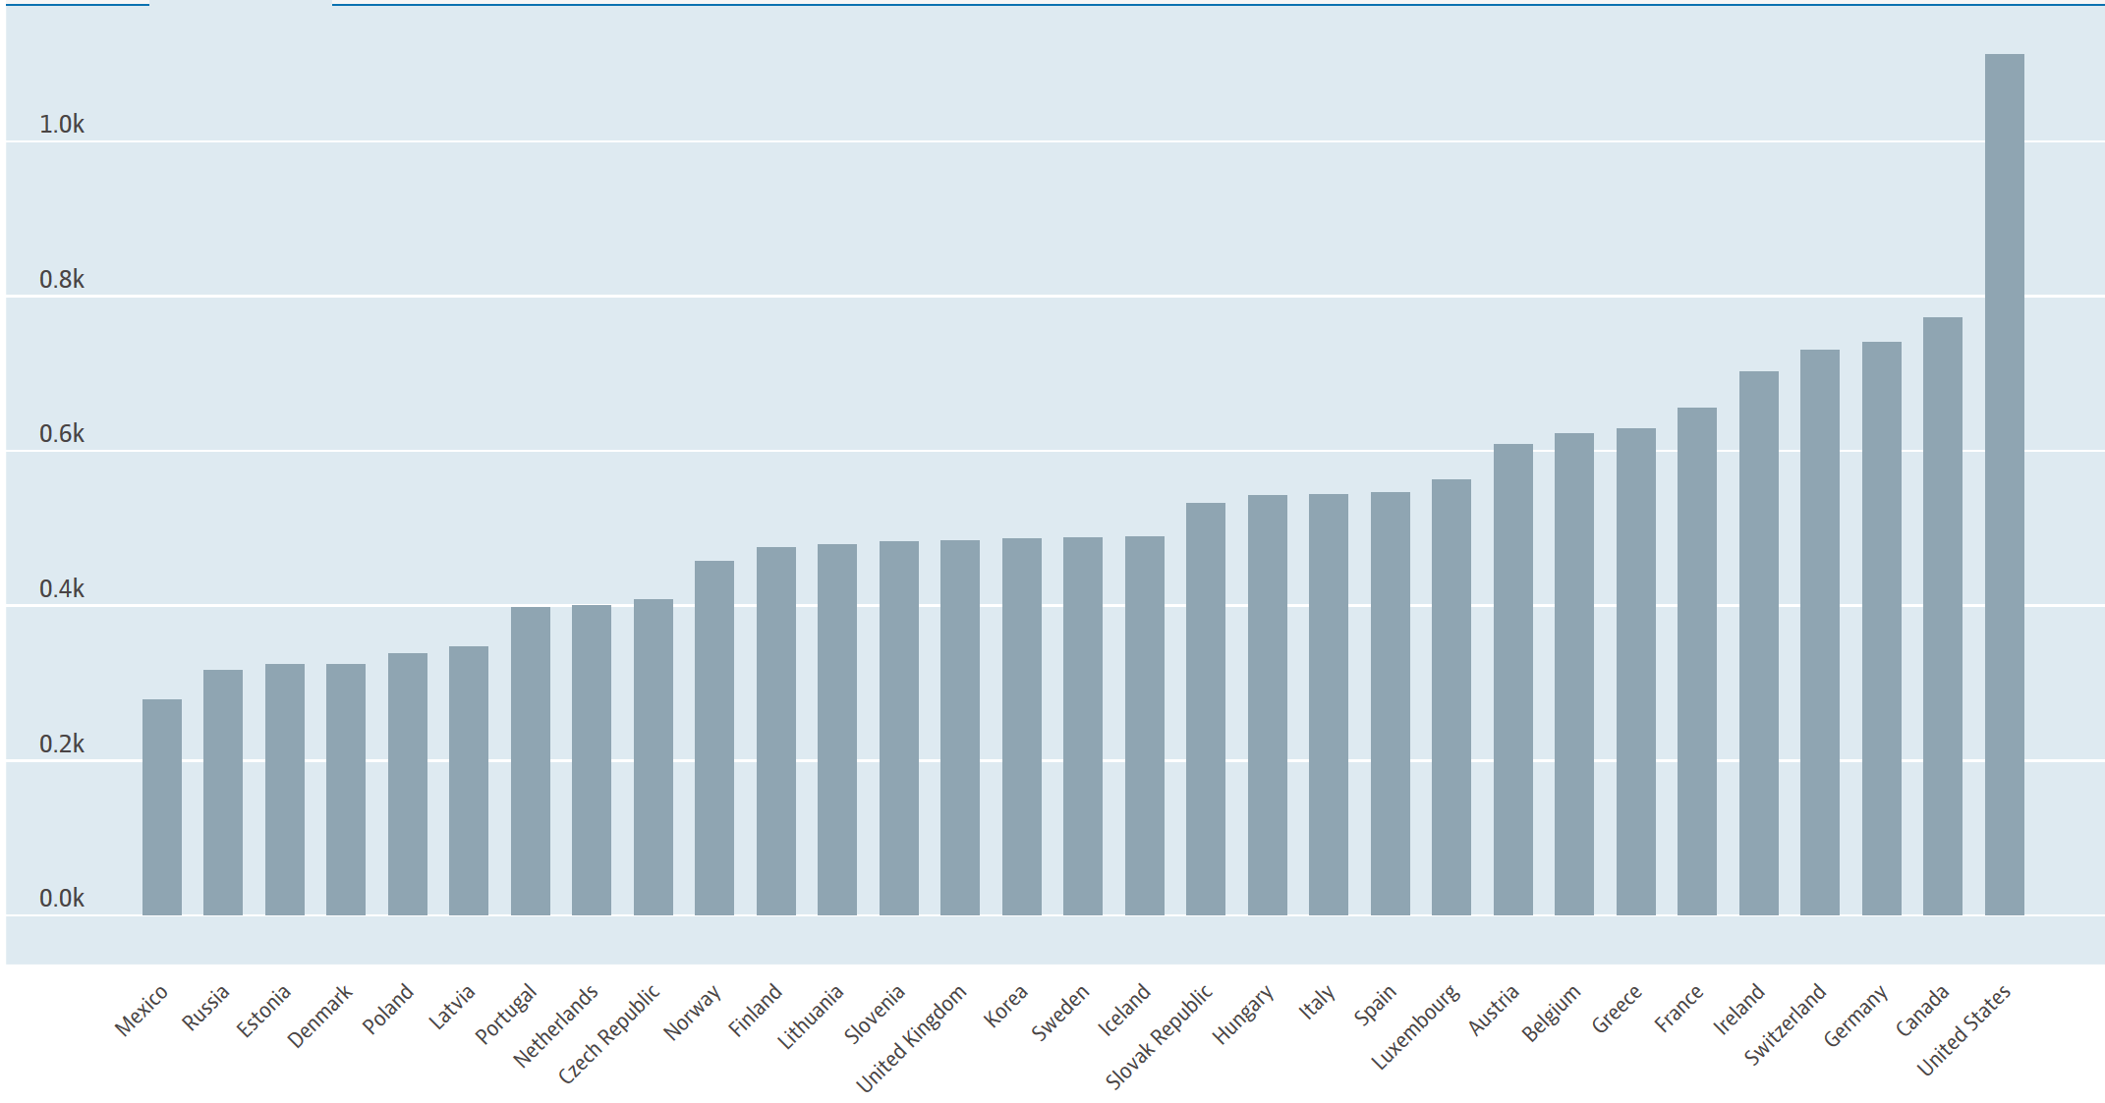
Big Pharma – per capita spending globally
Medicare is banned by law from negotiating drug prices
Even Obamacare did not end this obvious cost driver!
All other large economies negotiate their drug prices
https://data.oecd.org/healthres/pharmaceutical-spending.htm#indicator-chart

Slide 31
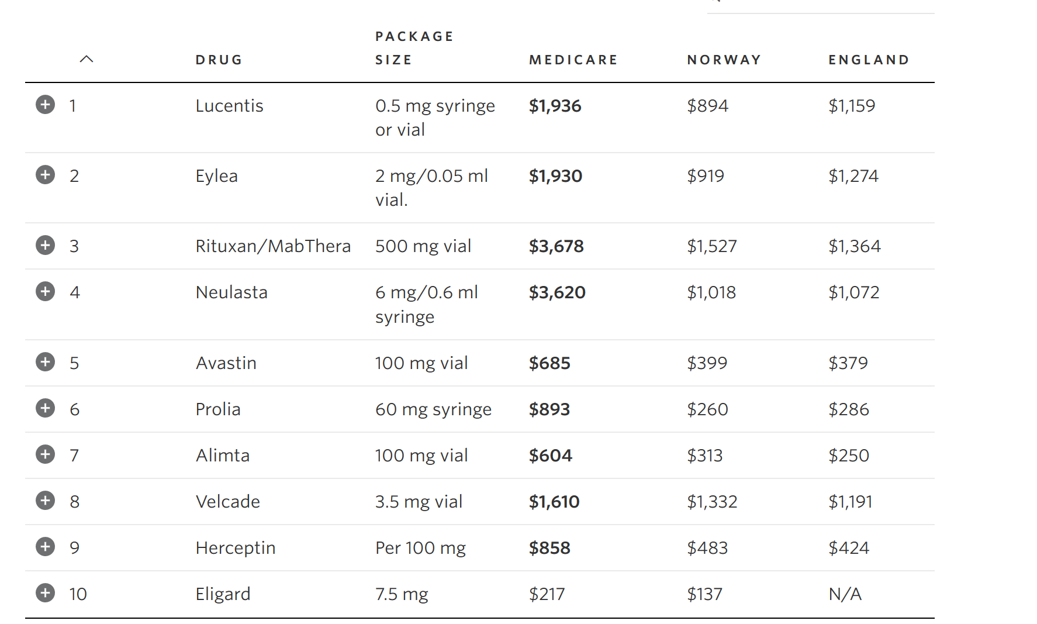
Big Pharma
Wall Street Journal, Why the U.S. Pays More Than Other Countries for Drugs, 12/1/15

Slide 32
For profit vs not for profit healthcare in the us
The distribution of profit and nonprofit hospitals in the United States emanates from pre World War II distribution of union labor – east of the Mississippi, it tracks the Mason Dixon Line
Unions were behind the establishment of Blue Cross Plans
These plans would not contract with for profit health systems in big union states
For profit hospitals concentrated in the South, with Nashville the preferred headquarters
Florida, Texas, Tennessee have large concentrations of for profit hospitals
This pattern has been breaking up in the last two decades – next slide

Slide 33
For profit vs not for profit healthcare in the us
The idea that the large not for profit hospital systems are “nonprofit” is patently ridiculous; exemption from income taxes creates an enormous distortion in operating policies, however
Go to Guidestar and review form 990 for any such system and see how much the executives get paid
Smaller nonprofit systems that actually cater to the poor lack the negotiating clout with insurers of the academic teaching hospital systems and cannot compete for doctors or facilities
The “premium pie” is fixed – if your slice is bigger, mine is smaller
Equity capital is buying up these weak nonprofit systems, improving facilities, recruiting physicians & going to bat against insurers for better payments - driving the cost spiral ever higher

Slide 34
Where does this all lead us?
You cannot “fix” the individual insurance market
IF we are going to regulate insurance, which is Obamacare’s sole “achievement,” then
Merge all three insured markets into one risk pool, and charge the self-insured – like Jonathan Gruber – a fee to subsidize the preexisting conditions in the merged risk pool
Any good actuary can figure that out
The idea of a consumer “marketplace” for insurance is as silly as a consumer marketplace for do-it-yourself joint replacement – the skill set does not exist
Establish a limiting charge for hospitals, doctors and other providers
The “savings” that self-insured and large groups negotiate from health insurers and healthcare providers get passed down to those with less negotiating clout!
Medicare already has a limiting charge for non-participating doctors, so precedent is there

Slide 35
Where does this all lead us?
Single payer is a joke without a laugh
Medicare is highly politicized and does not allocate resources fairly, whether across populations, states, regions or any other factor you want to employ – been there, seen it
Obamacare did not “bend the cost curve” – if it had, why would premiums be skyrocketing? At most, one can argue it reduced the growth rate of Medicare spending by increasing spending in the commercial insurance markets on the non-Medicare population – long called cost-shifting
Yes, older people should pay more than younger people for their insurance
The 4th estate’s baloney about the AHCA “harming” older people by changing the premium ratio from 3x to 5x never mentions the fact that young people are getting hosed by the existing ratio!
This is one of the many reasons Obamacare failed

Slide 36
One more from sir winston
“Long speeches are not suited to the times in which we live,* and, therefore, I shall detain you” no longer.
*or the time allotted to me

