Slide 1
Understanding AccountLease™ and the
Integra/Cresa Relationship
May 19, 2017
Integra AAANZ Conference
Philadelphia, PA

Slide 2

AccountLease™

Slide 3
Countdown Before Implementation
590 days until……………January 1, 2019
225 days to gather
January 1, 2018 data
ZERO days to gather 2017 data
THE TIME IS NOW!
3

Slide 4
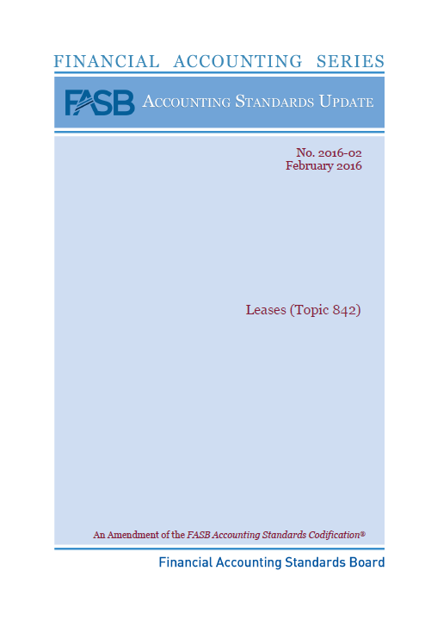
Overview
FASB issued a new standard
Topic 842, Leases
February 25, 2016
Effective for annual periods beginning AFTER
December 15, 2018 (public entities)
December 15, 2019 (non-public entities)
EARLY ADOPTION IS PERMITTED BY ALL ENTITIES
4

Slide 5
Key Points
The new standard has extensive guidance on the identification of a lease.
Segregating lease and non-lease (service) components in a lease contract will be a new important process as only lease components will be recognized as lease assets and lease liabilities.
Significant change in accounting for related party leases by shifting from a substance-based criteria in current US GAAP to accounting for related party leases based on their legally enforceable terms.
More transactions involving real estate sale/leasebacks will qualify for sale/leaseback accounting.
Practical expedients are available upon adoption of the new lease standard that permit, but do not require, an entity to avoid reassessment of lease classification for existing leases at the date of adoption.
5

Slide 6
Key Points (continued)
All leases (over 12 months) recorded on balance sheet:
  Short-term exception
  Treatment of variable payments
  Segregating non-lease components
  Initial direct costs
Many contracts contain both lease and non-lease (e.g., service) components. Some examples of potential non-lease service components include maintenance, cleaning, and repair services.
The lessee shall determine the relative standalone price of the separate lease components and the non-lease components on the basis of their observable standalone prices.
Allows a lessee to make an accounting polity election by class of underlying asset, to not separate non-lease components from lease components and, instead, to account for each separate lease component and the non-lease components associated with that lease component as a single lease component.
6

Slide 7
Key Points (continued)
Costs that meet the new definition of initial direct costs can be included in the capitalized right-of-use asset.
The new lease standard defines initial direct costs as the incremental costs of a lease that would not have been incurred if the lease had not been obtained and indicates that commissions may be an example.
A lessee should classify a lease as a finance lease and a lessor should classify as a sales-type lease when the underlying asset is of such a specialized nature that it is expected to have no alternative use to the lessor at the end of the lease term.
Recognize interest on the lease liability separately from amortization of the right-of-use asset in the statement of comprehensive income.
7

Slide 8
Why is the New Standard Necessary?
$3 trillion of lease obligations
85% NOT recorded (footnote only)
SEC registrants have $1 trillion
Airlines, retailers, other transportation companies have the highest percentage of non-recognized
SEC (under SOX) in 2005 called for these changes
8

Slide 9



Integra has the Solution!
(Probably the only Accounting Association ahead of the implementation game!)

Slide 10
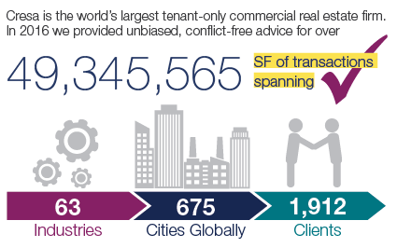
About Cresa
10

Slide 11
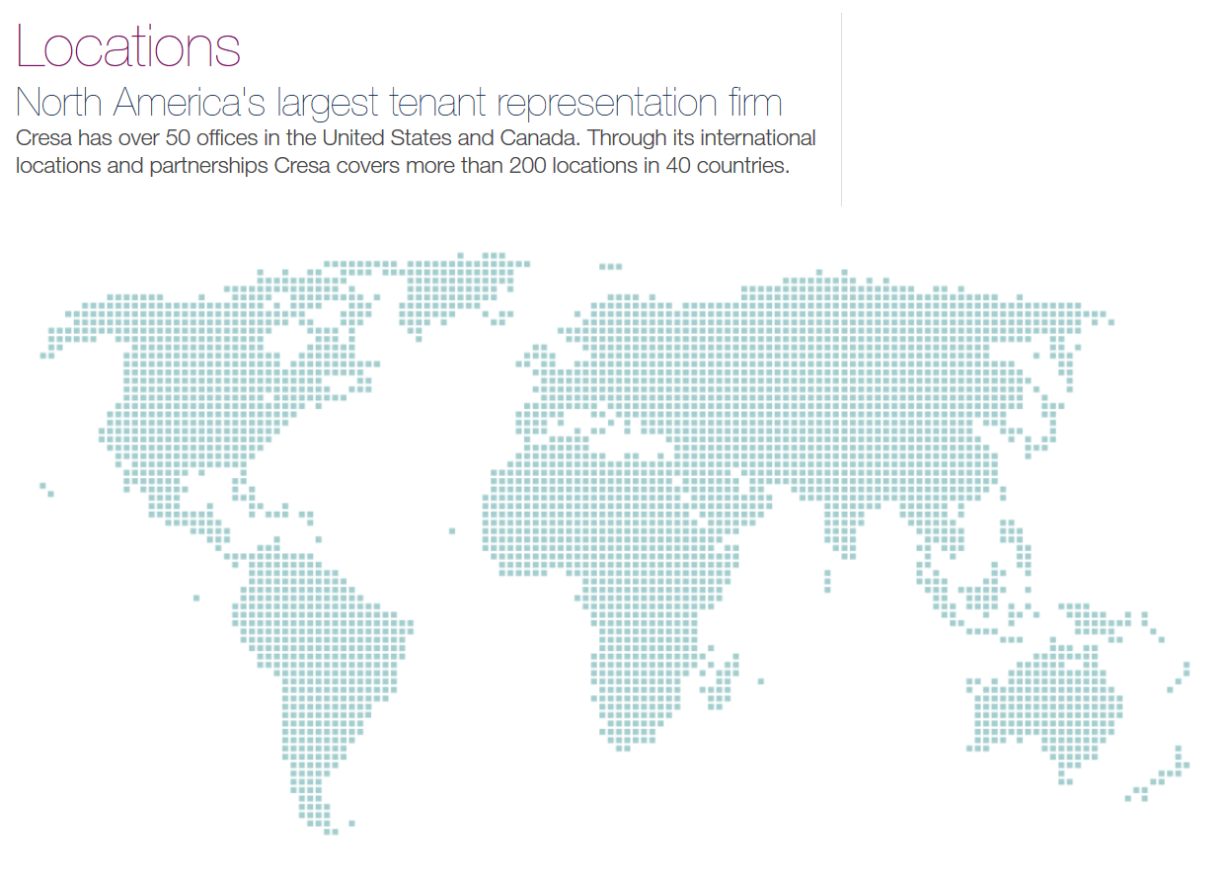
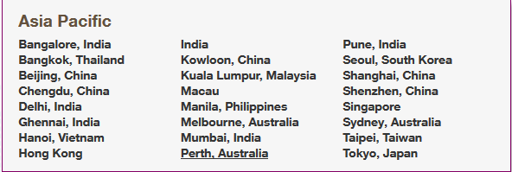
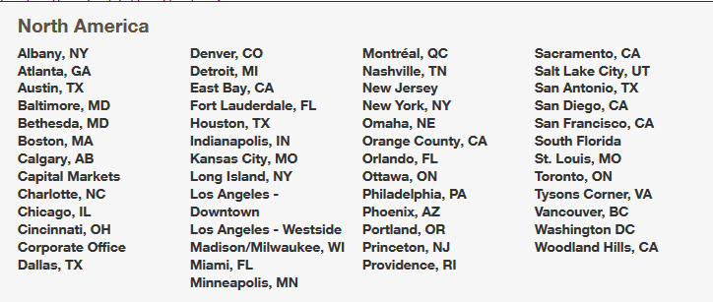
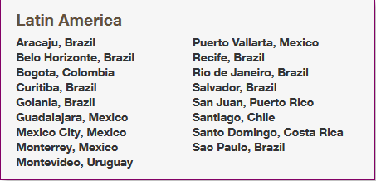
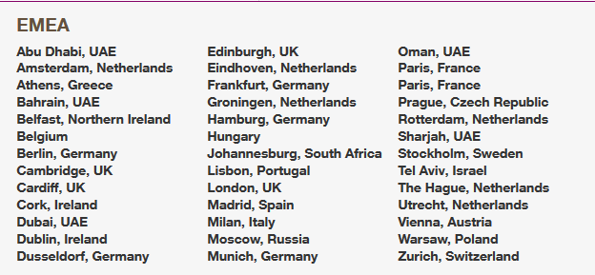
Cresa’s Global Footprint
11

Slide 12
Cresa Joins Integra
Integra International New Member
Press Release
October 21, 2016
Cape Town, South Africa (October 21, 2016) — During Integra’s World Wide Conference, the organization announced the admittance of Cresa as its newest Alliance Member. Integra’s Global Chairman, Doug White says “We are excited to welcome Cresa to our Integra family. Our goal is to provide our member firms and their clients the best tools available to help them succeed, and we see this alliance as part of that goal.”
12

Slide 13
AccountLease™
Lease Accounting Consulting Services
Adopting the New Lease Accounting Standard
The U.S. and international accounting standards boards (the FASB and IASB) have issued new lease accounting standards that will significantly impact corporate balance sheets.
Lease obligations are required to be accounted for on the balance sheets as a “right of use” asset and a lease liability. In order to calculate the effect, businesses will need detailed information and substantial analysis of their lease portfolio.
13

Slide 14
AccountLease™
Marketing and Promotion
Integra International Conferences
  Annual May Conference – Vancouver, BC, Canada
  Worldwide Conference – Cape Town, South Africa
  Annual May Conference – Philadelphia, PA
Integra Outreach
  10 informational calls with various Integra firms in the last six months
St. Louis, MO | San Francisco, CA
Philadelphia, PA | Miami, FL
Phoenix, AZ | Boston, MA
Los Angeles, CA | Dallas, TX
Washington, D.C. | Bethesda, MD
14

Slide 15
AccountLease™
Marketing and Promotion
Lunch & Learns
  12+ with banks, companies, and service providers
    Kleinfelder April, 2016
    General Finance May, 2016
    RA Capital April 17, 2017
    US Bank April 28, 2017
    Claiborne Advisors May 4, 2017
    Comerica Bank June 6, 2017
    Wells Fargo In progress
    City National Bank In progress
15

Slide 16
AccountLease™
Marketing and Promotion
Ad Campaign – Six Months
  San Diego Business Journal
16

Slide 17
How Does
Cresa Enhance Integra’s Ability to Assist in
New Lease Accounting?

Slide 18
Results – Last 12 Months
Swenson to Cresa
  San Diego Based Non-Profit Organization
  Real estate consulting $20,000
  10 Office Non-Profit in California
  New leases $35,000
  San Diego Based Alzheimer Non-Profit Organization
  Real estate consulting $500,000
  (over 10 years)
Cresa to Swenson
  Danish Emerging SD Company
  Audit and tax services $100,000
  (Over 2 years)
Joint AccountLease™ Engagement
  SEC Swenson client $75,000
  12 Months = Total new business of $700,000+
18

Slide 19
What’s
Next?

Slide 20
AccountLease™
Next Steps
Gather information about existing leases
Decide whether or not to apply the practical expedients
  May eliminate reclassifying leases and re-measurement of initial direct costs
  Maybe a factor in determining the timing and extent of the transition
Contact the professionals from Cresa or Swenson Advisors, LLP to learn more about AccountLease™ and how we can help you prepare for the future and implement these new standards
20

Slide 21
AccountLease™
A “Win-Win” Proposition For You and Your Clients
We are selling a potential “cost fee” solution.
This is a current solution for an enhanced, future capital event.
AccountLease™ is established to implement the solution now!
Bundled service that includes the accounting, lease negotiation, and analysis as well as the reporting and presentation expertise that you need for these new standards.
We offer the software, models, and methodology needed.
21

Slide 22
AccountLease™
Sample Approach to Implementation
22

Slide 23

AccountLease™
Swenson Advisors, LLP
AccountLease@SwensonAdvisors.com
(888) 757-8606
Cresa
AccountLease@Cresa.com
(858) 794-5500

