Slide 1

Future Conferences
Annual June Conference: June 22-24, 2017 Sofia, Bulgaria
Cross Border Tax Workshop September 16, 2017 St. Julian’s, Malta
Annual Global Conference: October 19-21, 2017 Tokyo, Japan
AAANZ Regional Conference May 17-19, 2018 Puerto Rico
EMEIA Regional Conference June 2018 Tel Aviv, Israel

Slide 2
Sophia, Bulgaria София България
June 22-24, 2017

Slide 3
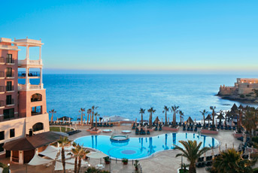
Cross Border Tax Workshop
September 16, 2017 St. Julian’s, Malta

Slide 4
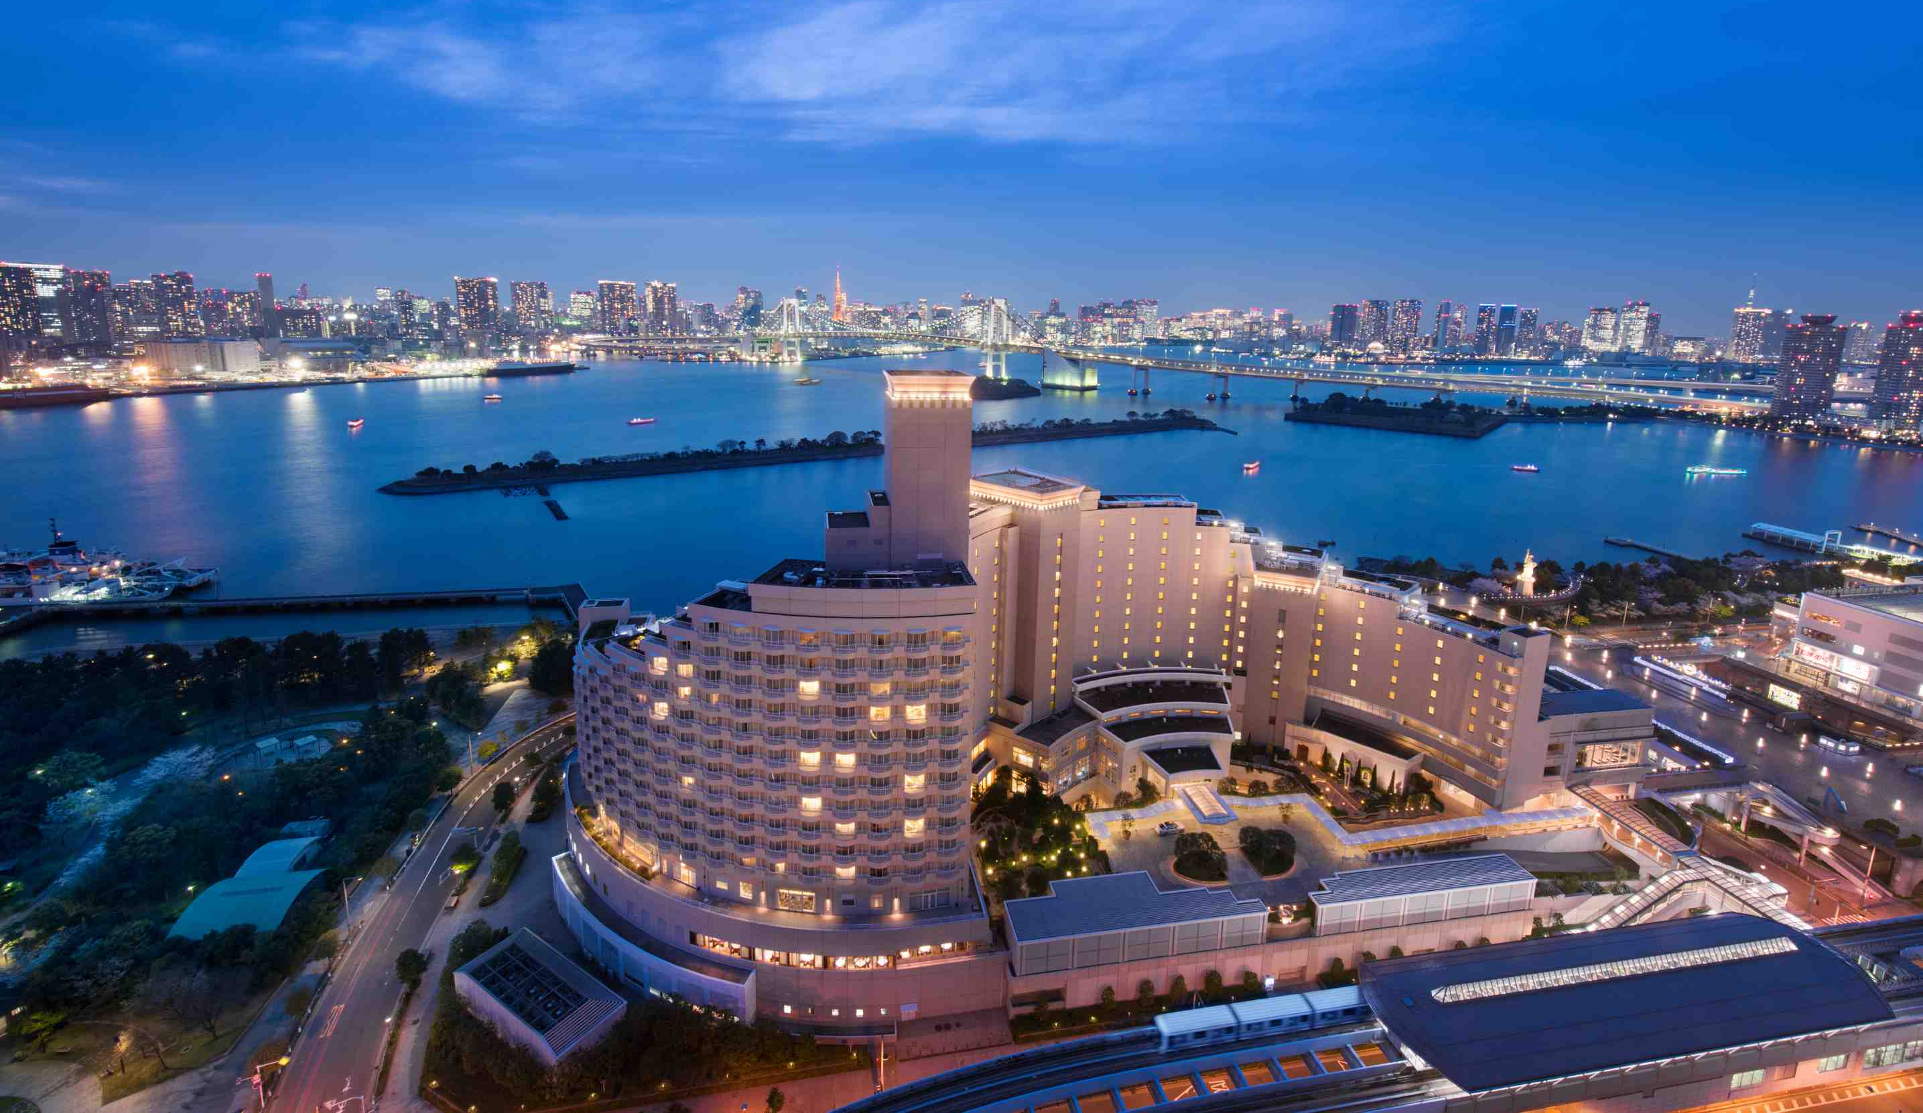
Global Conference Tokyo, Japan
日本東京、October 19-21 2017

Slide 5
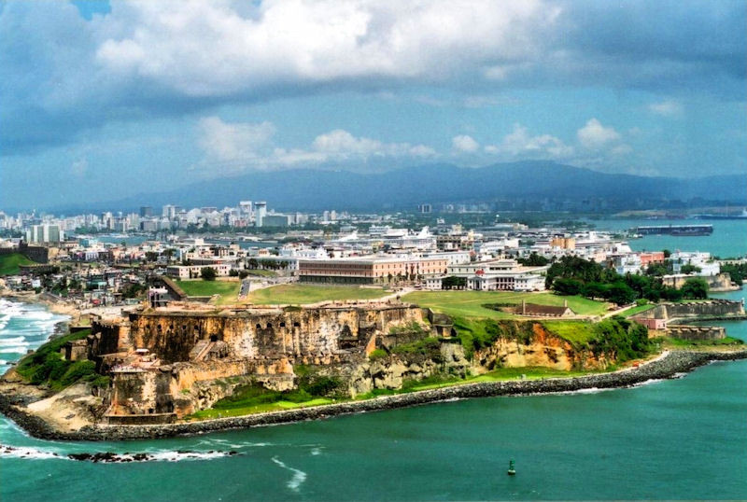
San Juan, Puerto Rico
May 17–19, 2018

Slide 6
Tel Aviv, Israel
June 2018

