Slide 1
Up In Smoke May 20, 2017
Stacey D. Udell, CPA/ABV/CFF, CVA
AAANZ Conference ● May 18-20, 2017 ● Philadelphia Gold Gerstein Group LLC

Slide 2
Thank you to RON SEIGNEUR (Integra member from Denver) for introducing me to the industry and for sharing your previous presentations, some contents of which have been incorporated into this presentation

Slide 3
Agenda
History
Tax and accounting issues
Valuation issues

Slide 4
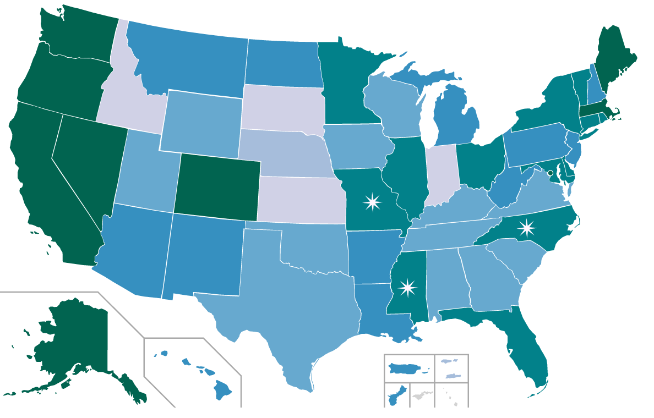
Cannabis Laws in the U.S. Source:https://commons.wikimedia.org/wiki/File:Map-of-US-state-cannabis-laws.svg
Recreational & Medical Legal
Medical & Decriminalization Laws
Legal psychoactive medical
Legal non-psychoactive medical
Decriminalized possession
Prohibited

Slide 5
Cannabis is Federally Illegal
Schedule I of the Controlled Substances Act
High potential for abuse
No currently accepted medical use in treatment in U.S.
Schedule II
High potential for abuse
Currently accepted medical use in treatment in U.S. or currently accepted medical use with severe restrictions

Slide 6
Schedule I & II Drugs
Schedule I drugs
Ecstasy, Heroin, LSD, Peyote, Quaaludes
Schedule II drugs
Cocaine, Codeine, Morphine, Methadone, Opium, OxyContin, Percocet

Slide 7
For any updates: https://www.mpp.org/states/
http://medicalmarijuana.procon.org/view.resource.php?resourceID=002481

Slide 8
The Larger Cannabis Industry It’s NOT Just POT
Medical Dispensaries
Retail Stores
Grow Facilities
Advertising & Marketing
Security
Enforcement
Product Development
Professional Services
Consulting Services

Slide 9
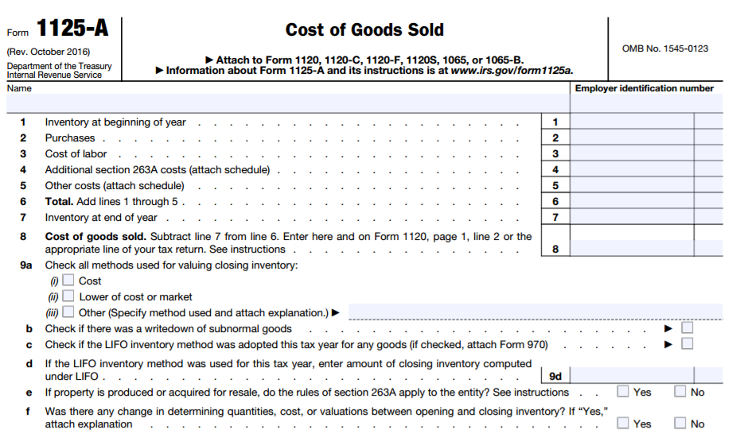
Taxes and Accounting

Slide 10
26 U.S. Code § 280E
“Expenditures in connection with the illegal sale of drugs”
Denies selling and administrative costs
Chief Counsel Memorandum (201504011) dated January 23, 2015 in materials

Slide 11
Court Cases
CHAMP v. Commissioner, 128 T.C. No. 14, Docket NO 20795-05, May 15, 2007
Olive v. Commissioner, T.C. No 14406-08, July 9, 2015
Feinberg/McDonald v. IRS, No. 15-1333, 2015, U.S. App Lexis 22161, 10th Circuit

Slide 12
Tax and Accounting - Ethics
An Issue Brief on State Marijuana Laws and the CPA Profession, Colorado Society of Certified Public Accountants, AICPA, Washington Society of Certified Public Accountants, updated January 8, 2016
http://www.aicpa.org/Advocacy/State/DownloadableDocuments/MarijuanaCPAsIssueBrief.pdf

Slide 13
States & Accounting Services
Colorado
Connecticut
Florida
Maryland
Nevada
Oregon
Washington

Slide 14
Professional Concerns
“Good moral character”
Acts discreditable
Competancy
Insurance

Slide 15
Tax and Accounting Issues

Slide 16
Income Tax Guidance
Federal Income Taxation of Medical Marijuana Businesses, Edward J, Roche, Jr. University of Denver Sturm College of Law, Working Paper 13-38, Winter, 2013
https://papers.ssrn.com/sol3/papers.cfm?abstract_id=2308946
Federal Proposals to Tax Marijuana: An Economic Analysis, Jane G. Gravelle, Congressional Research Service, November 13, 2014
https://fas.org/sgp/crs/misc/R43785.pdf

Slide 17
Income Tax Guidance
IRS Interpretation Causes Reefer Madness, Michael Kosnitzky and Matt Kaden, Taxes: The Tax Magazine, May 2015
https://www.bsfllp.com/images/content/1/4/v2/1495/MAG-05-15-Kosnitzky-Kaden.pdf
Marijuana Business and Section 280E: Potential Pitfalls for Clients and Advisors, Jeffery Gramlich and Kimberly Houser, The Tax Advisor, June 30, 2015
http://www.thetaxadviser.com/issues/2015/jul/houser-jul15.html

Slide 18
Valuation Methods and Standards of Value
Valuation Methods
Asset
Adjusted net assets
Market
Public company guidelines
Transactional data
Income
Capitalized future benefits
Discounted future benefits
Standards of Value
Investment value
Fair value
Fair market value

Slide 19
Valuation Challenges for Cannabis Related Enterprises
Fundamental appraisal concepts still apply
Internal Revenue Code Sections 280E, 61, 263A and 471
Growth rates and company specific risk assessment
Jurisdictional differences
Lack of market data

Slide 20
“Four Ls” of Cannabis
License
Lease
Location
Legislation

Slide 21
Using the Discounted Future Benefits Method for Cannabis Assignments
A relatively new industry with limited historical data
Historical data has evolved dramatically and is very jurisdictionally restricted
Lack of industry benchmarking information
Lack of management sophistication
Wide range of expertise and operational philosophies between cultivation, retail, ancillary, etc.

Slide 22
Company Specific Risk Premium
“The build-up method of discount rate determination includes an element for specific company and industry risk, which is the opinion of the valuator. Having considered the Company’s business tenure, its historical and expected results of operations, its client base, the industry within which it operates, the location of the Company, as well as other factors, we concluded that an additional risk premium of 30% is appropriate for the individual risk factors inherent in the Company, as further delineated on Exhibit P.
Utilizing the above mentioned components, we calculated the discount rate to be 45.8%.”

Slide 23
Other Selected Guidance
Marijuana Dispensaries: A Budding Industry Brings Opportunities and Challenges for Business Appraisers, Jim Marty and Ron Seigneur, Business Valuation Resources, 2015
Business Appraisal Within the Cannabis Industry: The Ultimate Business Challenge, Ron Seigneur, Financial Valuation and Litigation Expert, June/July 2015
The Evolving Cannabis Industry: Risk Assessment and Valuation, Ron Seigneur and Stacey Udell, Valuation Strategies, March/April 2016

Slide 24
Thank you!
Stacey D. Udell, CPA/ABV/CFF, CVA
Gold Gerstein Group, LLC
sudell@g3cpa.com
856-727-0100

