Slide 1
Marketing Interest Group
Mark Saunders
Let’s share meaningful ideas
Integra Conference, Sofia, June 2017

Slide 2
Why Marketing Interest Group?
Proposed to
address member requests for increased levels of marketing support
Bring together interested parties, both accountants and marketing professionals from member firms

Slide 3
Survey @ Vancouver Conference
Short survey sent to those who registered their interest
Questions to explore
Type of marketing activity in individual firms
Any sharable marketing skills
Type of support required from Integra centrally
Results summary
Many firms already are active with on- and offline campaigns
Social media development and Search Marketing of particular interest
Website development
Sharable skills include: online marketing, copy writing, case studies of campaigns run, social media content, printed content

Slide 4
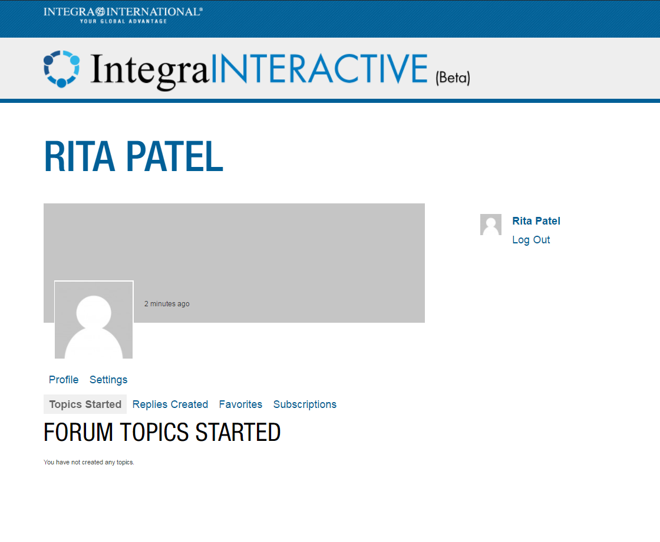
Introducing Integra Interactive

Slide 5
Integra Interactive
The new intranet will enable us to:
Pictures and
web links
New ideas
New initiatives
Marketing material
created for offline
use
Case studies reflecting
on marketing activities
of all types

Slide 6
LinkedIn Advertising
A Wilder Coe Case Study

Slide 7
Background
One of our partners has strong expertise in the Field of SEIS/EIS tax reliefs. The Enterprise Investment Scheme is designed to help smaller, higher-risk companies raise finance by offering tax relief on new shares in those companies that qualify. For the investor, it’s a tax efficient way to invest in small companies.
SEIS is an incredibly generous derivative of the Enterprise Investment Scheme (EIS). Its aim is to encourage seed investment in early stage companies.

Slide 8
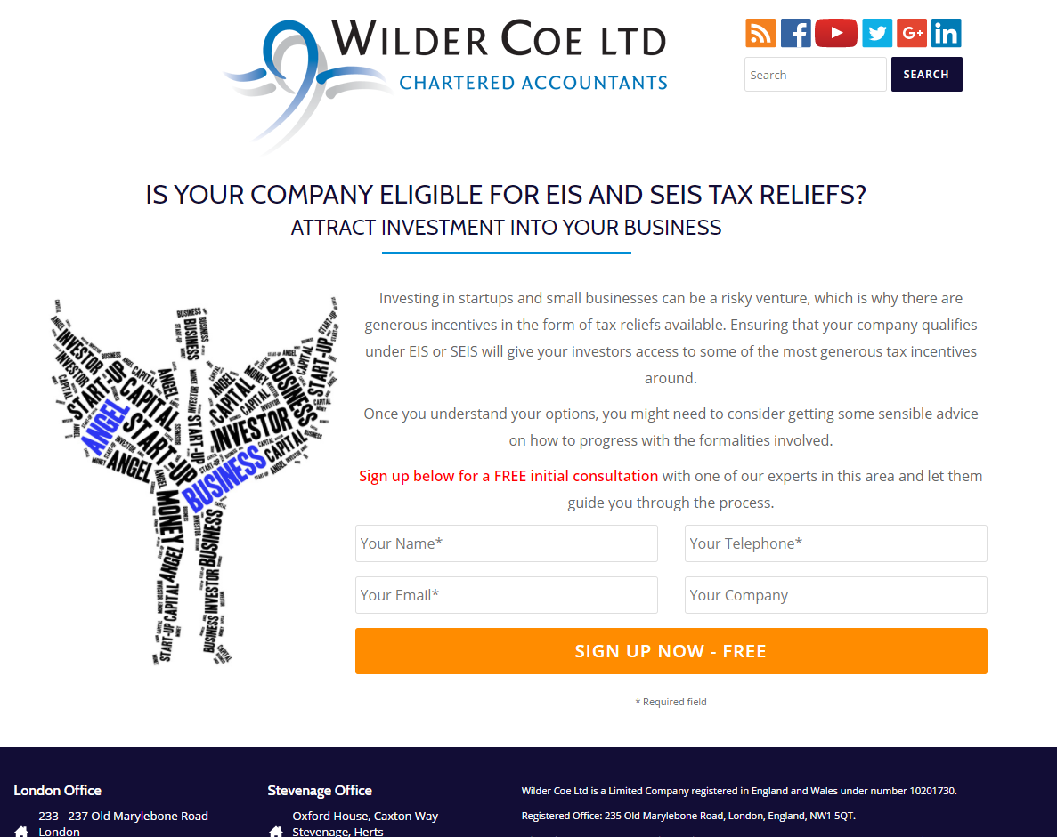
Landing Page

Slide 9
Landing Page – Key Considerations
Clean layout without any clutter – remove any unnecessary links which could distract your target
Go easy on the text – avoid the need to scroll. Ensure the visitor can see your Call to Action (CTA) button without having to scroll. Be succinct and precise and ensure your audience understands what you want from them.
Clear CTA – ensure it is crystal clear for anybody what it is you want them to do on the website. Do you want them to download something, should they call you? Confused visitors will click away and not convert. In our case we were giving away a free initial consultation to discuss the scope of work and circumstances of the company.
A clean and very short form - in most cases campaigns like these are lead generation campaigns: you are trying to gather information such as names, email addresses and phone numbers. Ensure your form is visible, short and very clear – the longer the form the more off-putting it becomes
Required fields - Ensure you mark the fields on your contact form as clearly as possible. Incomplete or random information has never been helpful
Images – Only one featured image which says it all.

Slide 10
A/B Testing
Trying different combinations of ad copy vs target to see what works best
The change can be as minor or as major as required
Budgets to be split equally to start off with
As the best and worst performers come to light, budgets are required to be allocated accordingly

Slide 11
Defining Your Target
Who should be the audience to our messaging?
Management consultants advising start up businesses
Owners/key people in small tech start up organisations
Anyone with an interest in attracting investment
LinkedIn offers target specification, we selected:
Job title: CEO/Founder/Managing Director/Co-Founder etc.
Industries: Computer software, Internet, Telecommunications, Computer games and other tech industries
Company size: 1-10 and 11-50 employees
Groups followed: Start-up investment and business funding groups

Slide 12
Follow-up Process
Each registration on the landing page triggers a notification email
Each email is one lead generated
Our follow up process:
Reply to notification via email with a thanking holding message
Within 24-48 hours: phone call to make an appointment
At the appointment: face to face or phone (as agreed)
Email confirming conversation
2 more attempts to follow up by phone leaving reasonable time in between each contact point

Slide 13
Campaign Performance
General metrics as above
Excellent Click through rate of nearly 0.6%
Standard CTR for LinkedIn campaigns:
0-0.35%: improvement needed
0.35-0.5%: standard
0.5-1%: excellent
Total clicks achieved: 128
Budget was hugely restrictive with a minimum cost per click of £4

Slide 14
Lead Generation
3 leads generated:
Lead 1: seemed like someone who was looking for free advice
Lead 2: in conversion process
Lead 3: in conversion process

Slide 15
Conclusion
Excellent metrics were achieved which means that the ads were optimized and the target showed sufficient interest.
This method seems to be a very accurate method of targeting the right kind of people if the budget to put behind it was sufficient.
Especially if budgets are being slit up by A/B testing the campaign becomes very restrictive in performance.
Clicks are very expensive (£4). Once budget is reached impressions stop.

Slide 16
Thank you!
Any Questions?

