Slide 1



Slide 2
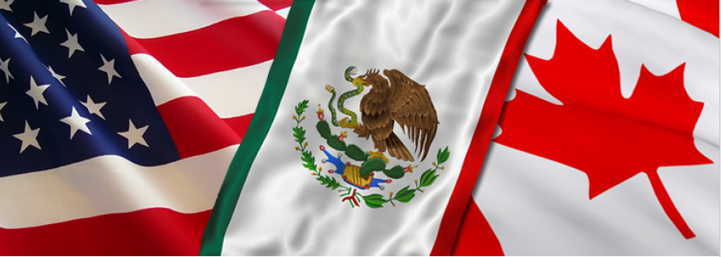
USMCA

Slide 3
Relevance of USMCA
in the
Population of
482
million
people
between countries.
Free Trade
It’s the largest
zone in the world.
Market value
20.5 billion dollars.
14 million
jobs in the U.S.
USMCA related.
16%
of world trade.
It represents more than
US Mexico trade has grown
6 times.
28% of the world’s GDP.
U.S. and Canada trade has grown
Mexico became
US trade partner.
the largest
9 times.
(CHINA VS. U.S.)
Notes:
NYT
Tariffs go billion US goods

Slide 4
Growth of global economic trade reached
3,1% in 2018.
Electoral processes around the world during the last two years. (United States, Mexico, part of the European Union and Latin America).
INTERNATIONAL
GEOPOLITICAL CONTEXT
Global trade confrontations (China, Canada, European Union, Japan, Iran, Turkey and Mexico) for the protectionist stance of the United States government.
Notes:
Trade war China vs US, instantlly benefits Mexico. (China competitor)
Long term affects global trade.

Slide 5
USMCA “WORST TRADE DEAL EVER”
Trump is on campaign again
U.S. – MEX
China
Wall
Negotiations
via
Twitter.
Threats to leave USMCA and shut the border.
INTERNATIONAL
GEOPOLITICAL CONTEXT
Re-negotiation of USMCA during presidential elections and transition in Mexico.
US renegotiate to eliminate trade deficit….
Which INCREASED 10% in 2018.
U.S. global trade deficit is at a record of
900 billion USD.
Notes:
Border is open for legal immigration.
What is good in Mexico is Free Trade.

Slide 6
Consequences of closing the Border.
In 2018:
Almost 13 million trucks
, more tan 22 thousand trains
150 million light vehicles,
more tan 90 million pedestrians
Crossed the border .
More than 85% of the trade between Mexico and the United States occurs by land border crossings.
Daily:
Daily numbers
1 million people and 300, 000 vehicles cross the border legally each day.
US MEXICO TRADE = 1 million dollars per minute (more than 1,400 million dollars per day).

Slide 7
Adverse effects on the economy of 90 million people living in border States.
More Consequences
10 from U.S. and
6 from Mexico.

Slide 8
MEXICO´S NEGOTIATION TEAM
Ministry of Economy. Experienced team.
NEXT DOOR ROOM. Link between the private sector and Ministry of Economy.
Balance of Political interests prioritized over economic and commercial indicators.
Negotiation strategy of the U.S. led to threats and a trade war with its key partner.
Impact of the negotiations on the Mexican Peso and volatility for issues in emerging markets.
Application of tariffs to Mexico according to rule 232 of "national security".
Notes:
Mexico spoke about modernization; U.S. about renegotiation.
Regional competitiveness certainty due of law inclusive trade.

Slide 9
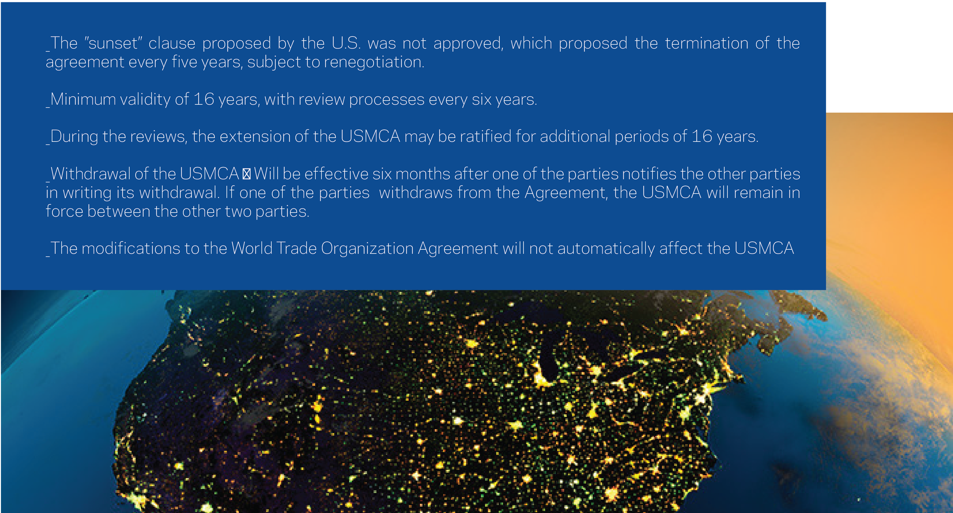
POISONED PILLS = DEAL BREAKERS
1. The “sunset” clause.
2. Seasonality
3. Deficit Reduction
4. Automotive
5. ISDS

Slide 10
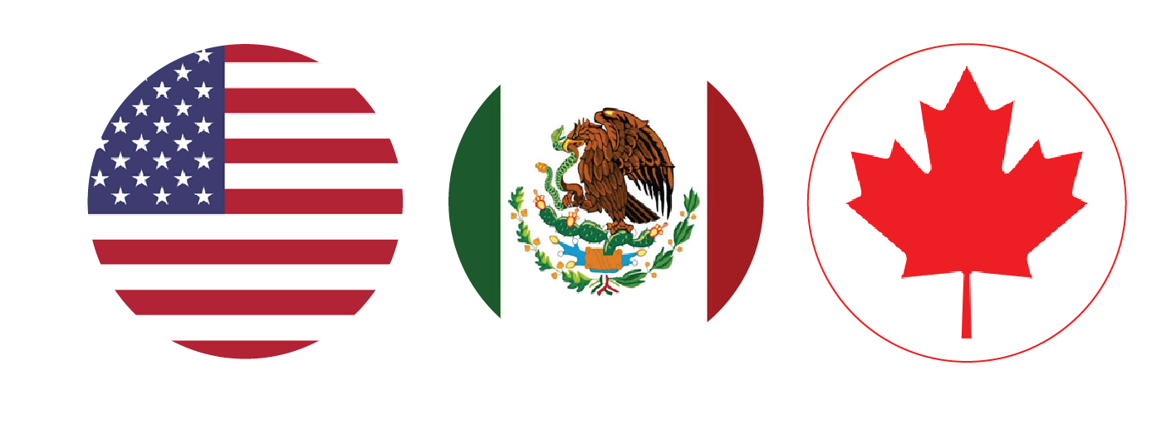
U.S. – Mexico – Canada Agreement (“USMCA”)
34 Chapters
(14 New Chapters)
4 Exhibits
12 Side Letters

Slide 11
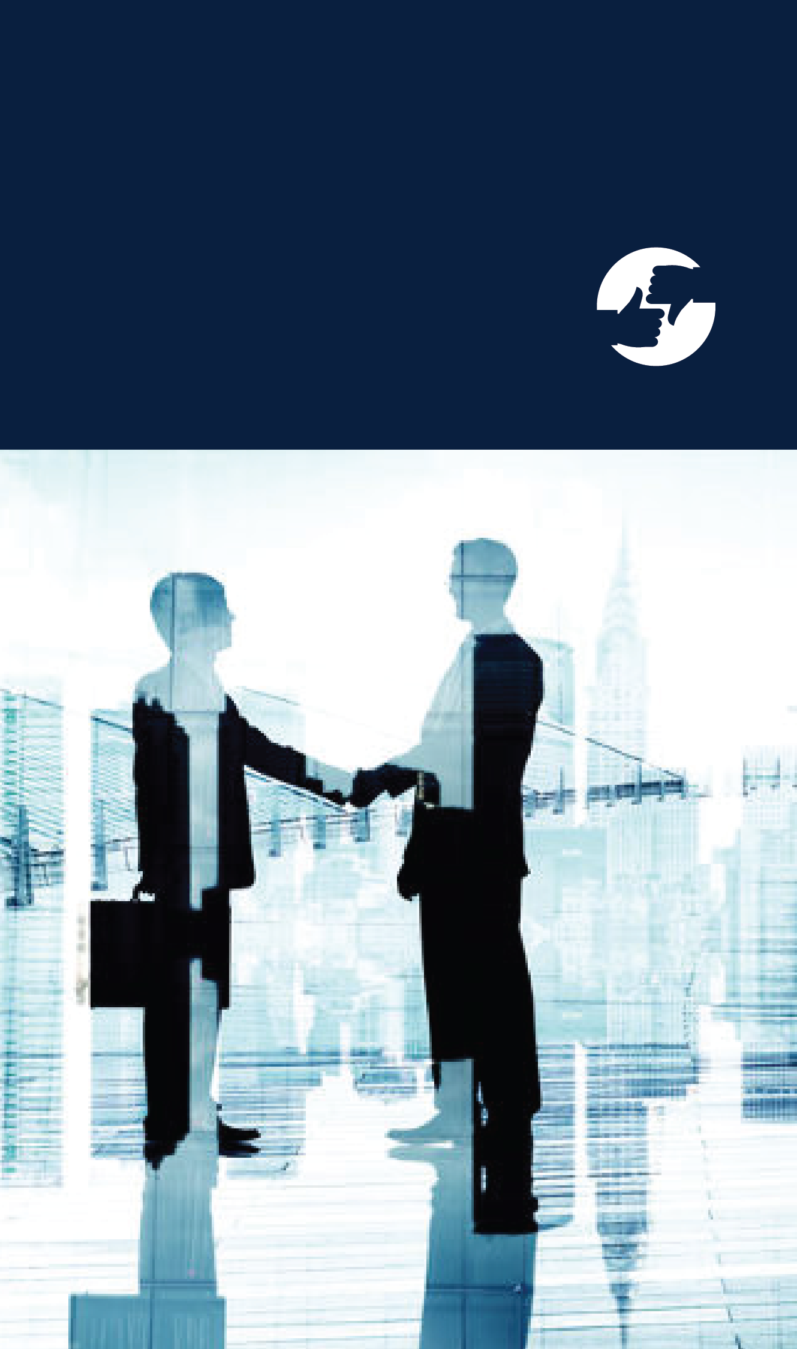
INVESTOR STATE DISPUTE RESOLUTION
Background: TPP
Chapter XI – Protection over Investments (now Chapter XIV):
Dispute settlement mechanism between an investor and each of the parties through arbitration.
U.S. Position
Mexico Position
Canada Position
Notes:
U.S. said we´re disciminated, so proposed local courts.
If fighting with mike Tyson, do it with gloves.

Slide 12
USMCA: where are we today?
Elimination of steel and aluminum tariffs by section 232 (before ratification).
Labor Reform 04/30/2019
Study of the impact of the USMCA presentation, by the International Trade Commission to the US Congress.
Tensions between the Democratic Party and the Trump Administration for domestic (Muller report) and international matters (eventual border closure with Mexico).
President Trump´s threats to leave the USMCA.
Tariffs for steel and aluminum by section 232 (before ratification).
Legislative session until June 15.
Times of ratification for the USMCA by the US Congress.
Federal elections in October 2019
Notes:
Mexico: Elimination of steel and aluminum tariffs by section 232 LOADED WEAPON.
Canada: tariffs for Steel and aluminum FIRM REQUIREMENT.

Slide 13
Perspectives on the approval procedure in the U.S.
A majority is required in both chambers to approve the USMCA.
However, leader Pelosi will not start the voting procedure if the vast majority of Democrats oppose the USMCA.
USMCA is used as a hostage in the political negotiation of the Democrats and Republicans.
Democratic Priorities
Risks and opportunities for Mexico
Mexican labor reform
-Reform approval
-Security that the USMCA commitments are implemented
-Budget resources for its early implementation
Elimination of tariffs 232 vs steel and aluminum
Biotechnological medicines
-Price of the medicines (high democratic priority)
-Democrats perceive that USMCA would reduce room to modify U.S. legislation that protects for 12 years, although the USMCA only establishes 10 years.
Compliance with labor commitment
Verification mechanism of export, with possible commercial penalties.
Resolve the weaknesses of the dispute resolution mechanism.
232 vs Steel and aluminum
Chance to eliminate 232.

Slide 14

SCENARIOS FOR THE USMCA IN USA
The probability of USMCA approval before August has decreased.
Initiation of the formal discussion in U.S. Congress in May
Pelosi designs and implements a political strategy to initiate the USMCA discussion procedure.
Concludes in July, before the August break
OPTIMISTIC
August 2019 approval
50%
Pelosi does not initiate the procedure for voting
Threatening a victory for Trump before the unions, especially in the automotive sector.
Recognizing the democrats division between the pro and anti USMCA.
During the electoral process, 2020 threatens to leave USMCA
PESIMIST
USMCA is not approved in 2019
50%
MEXICO STRATEGY
Notes:
MX. Move Economid players in U.S.

Slide 15




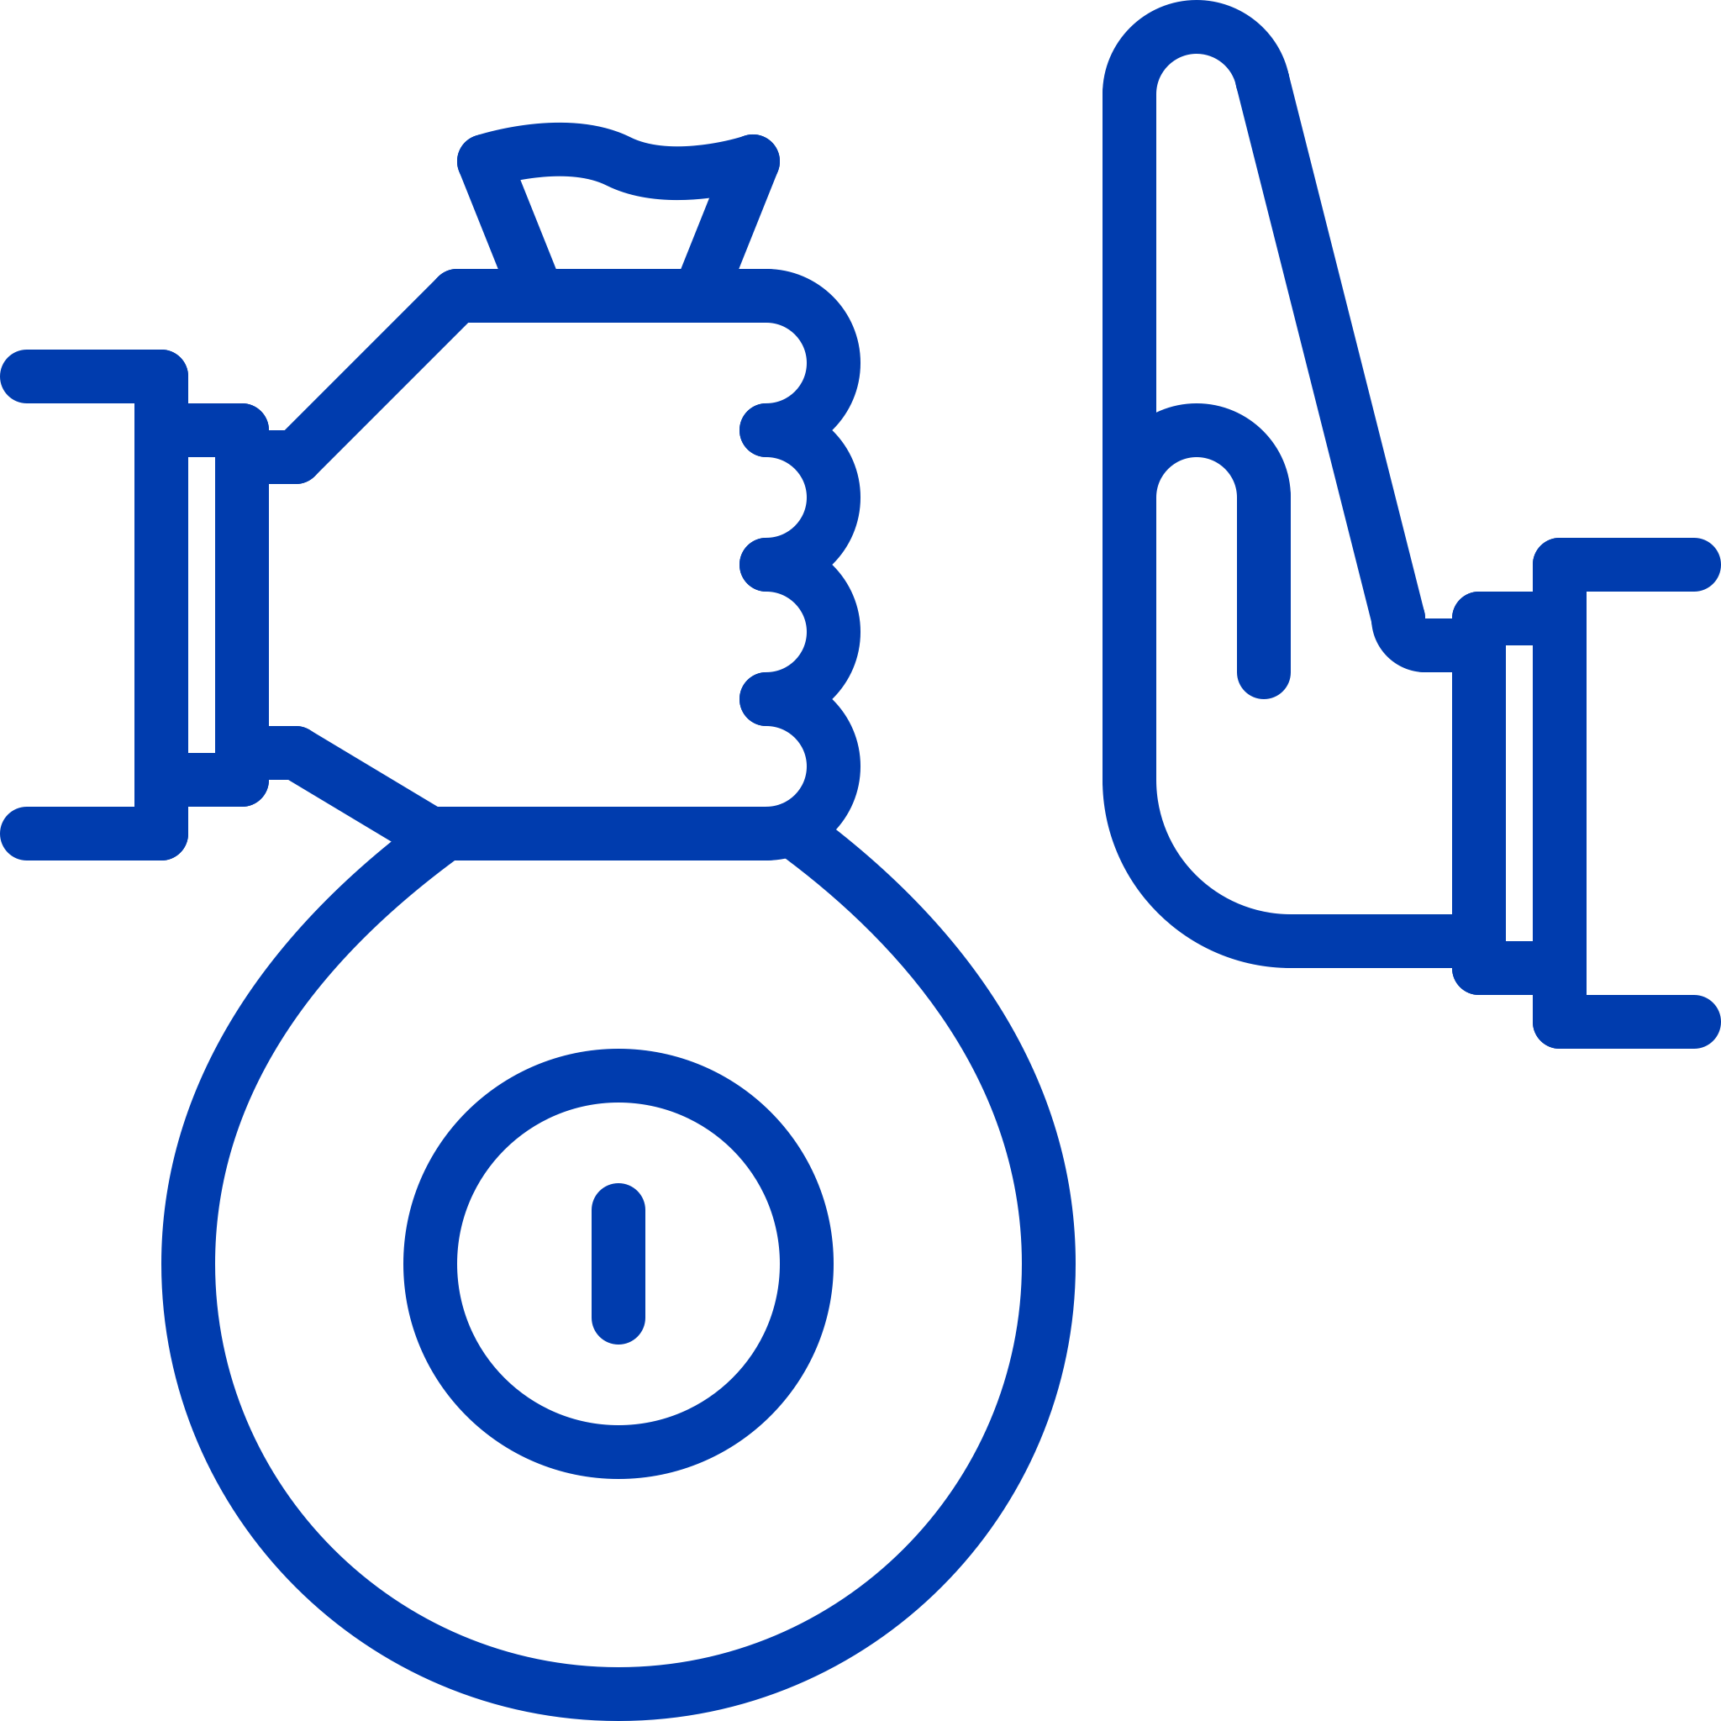
New
Chapters
E - Commerce
Telecommunications
Competitiveness
Pymes
Anti-corruption
Notes:
Anti-corruption
Commitment of the three countries to eliminate corrupt practices. The principles and provisions included is International Conventions are acknowledge and ratified.
Obligation to improve the integrity of the public officials, by implementing:
procedures, code of conduct, and report of crimes.

Slide 16
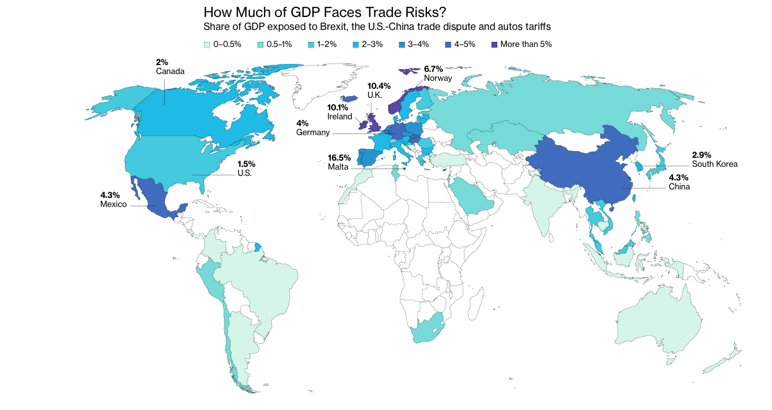
These countries have the biggest trade risks
The backlash against globalization comes with a heavy Price
A wave of disruptions is rocking the world trading system: Brexit, the U.S. – China trade dispute and possible car tariffs. The cost of such risks is substantial. About 2.3% of global GDP is tied to trade flows that are at risk from greater protectionism, equivalent to almost $2 trillion in output. And while higher tariffs would dent that activity – it wouldn’t wipe it out.

Slide 17





Ciudad de México
Paseo de la Reforma 222, piso 9
Colonia Juárez, Del. Cuauhtémoc
Ciudad de México, 06600. México
T. +52 (55) 5540-1737
Guadalajara
Av. Universidad 604
Torre Plata, pisos 1 y 3
Zapopan, Jalisco, 45116. México
T. +52 (33) 3630-0580
Bajío
G100 Business District
Plaza de la Paz 102 Int. 702
Puerto Interior, Silao, Gto. 36275. México
T. +52 (472) 500-0143

